Slide 1
ASP.NET Web API 2:
Routing
Nguyễn Văn Mạnh

Slide 2
I.Routing
Convention-based routing
Attribute routing

Slide 3
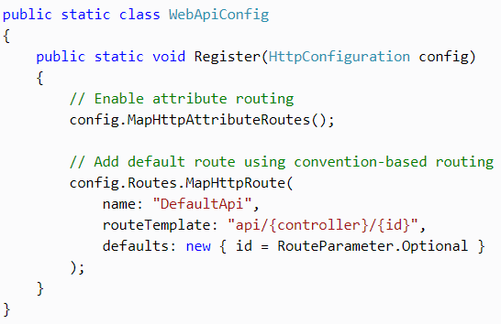
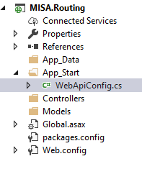
1. Convention-based routing

Slide 4
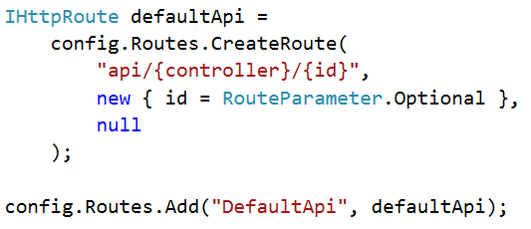
1. Convention-based routing
Create a new route and add it into a collection manually

Slide 5
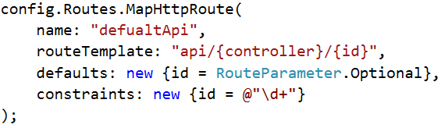
1. Convention-based routing
Parameters of MapHttpRoute() method

Slide 6
1. Convention-based routing
Understand routeTeamplace
routeTemplate: "api/{controller}/{action}/{id}"
1. "api" is a literal path segment
2. {controller}, {action} and {id} are placeholder variables

Slide 7
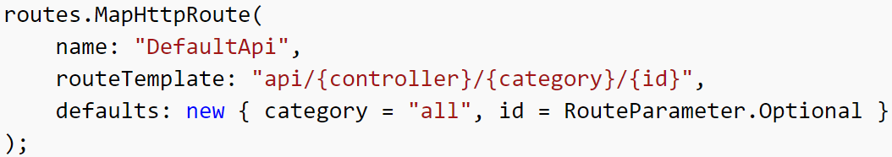
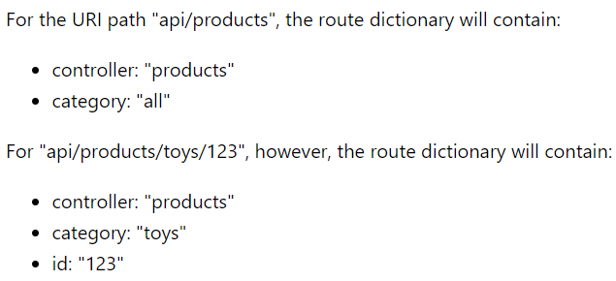
1. Convention-based routing
Understand defaults

Slide 8
1. Convention-based routing
Understand constraints
Regex expression to specify characteristic of route values

Slide 9

1. Convention-based routing
HTTP Method
Name of the controller method starts with "Get", "Post", "Put", "Delete", "Head", "Options", or "Patch"

Slide 10
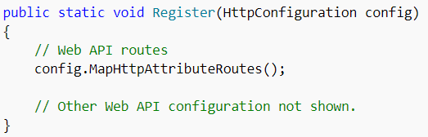
2. Attribute routing
Enabling Attribute Routing

Slide 11
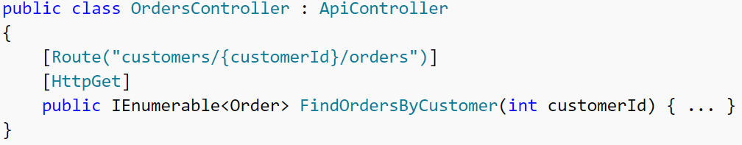
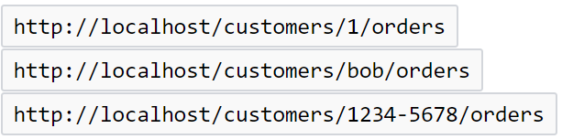
2. Attribute routing
Adding Route Attributes

Slide 12
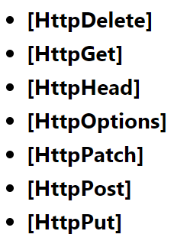
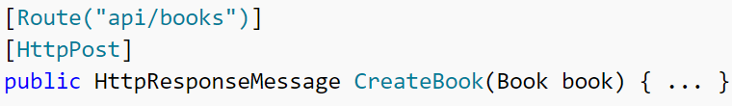
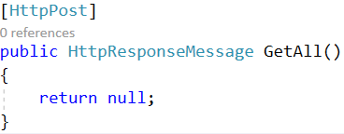

2. Attribute routing
HTTP Methods

Slide 13
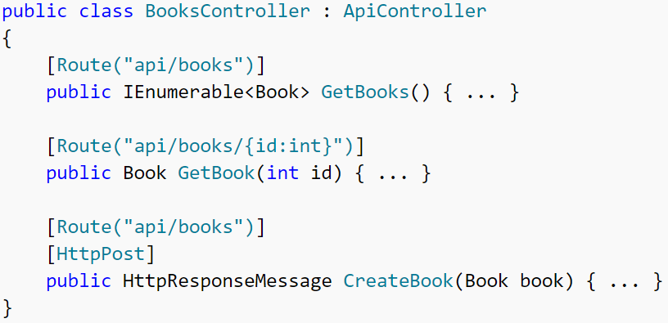
2. Attribute routing
Route Prefixes

Slide 14
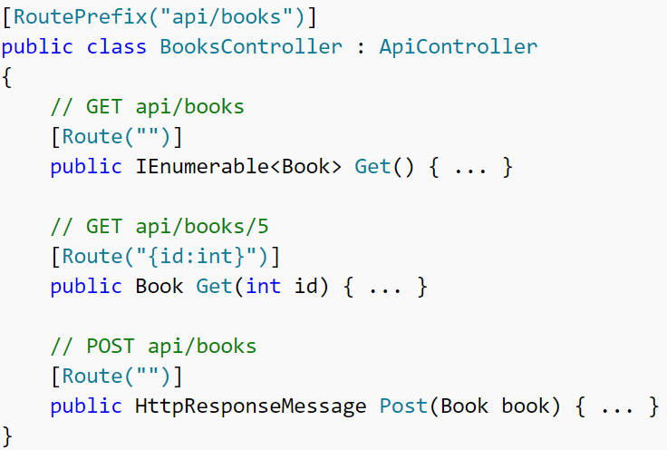
2. Attribute routing
Route Prefixes

Slide 15
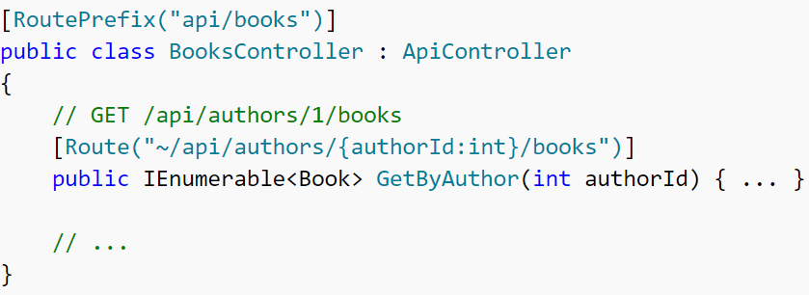
2. Attribute routing
Override the route prefix

Slide 16
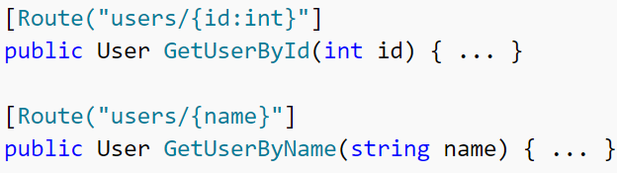
2. Attribute routing
Route Constraints

Slide 17
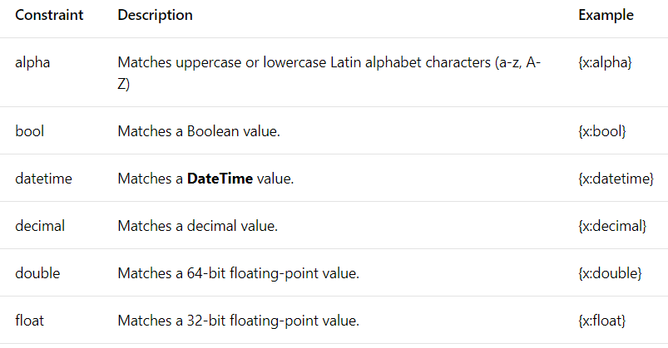
2. Attribute routing
Route Constraints

Slide 18
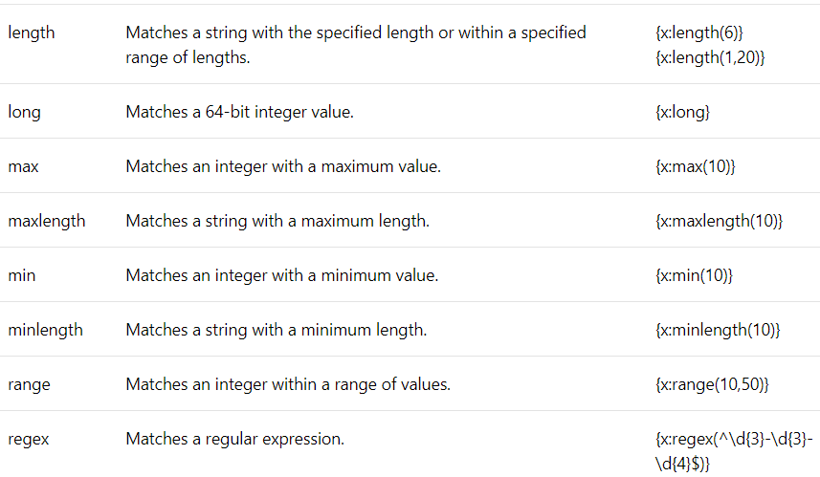
2. Attribute routing
Route Constraints

Slide 19
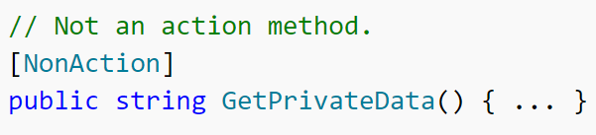
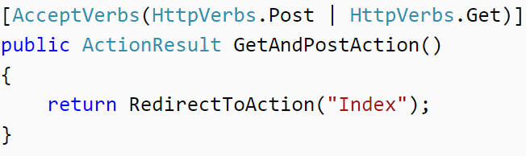
2. Attribute routing
Other Attribute
[NonAction]
[AcceptVerbs]

Slide 20
Routing and Action Selection
Route Dictionary
If the framework finds a match for a URI, it creates a dictionary that contains the value for each placeholder
A default can have the special value RouteParameter.Optional. If a placeholder gets assigned this value, the value is not added to the route dictionary

Slide 21
Routing and Action Selection
Route Dictionary

Slide 22
Routing and Action Selection
Selecting a Controller
1. Look in the route dictionary for the key "controller"
2. Take the value for this key and append the string "Controller" to get the controller type name
3. Look for a Web API controller with this type name

Slide 23
Routing and Action Selection
Selecting a Controller
If the route dictionary contains the key-value pair "controller" = "products"
Then the controller type is "ProductsController"

Slide 24
Routing and Action Selection
Action Selection
HTTP Methods: The framework only chooses actions that match the HTTP method of the request, determined as follows
1.HTTP method with an attribute: AcceptVerbs, HttpDelete, HttpGet,
HttpHead, HttpOptions, HttpPatch, HttpPost, or HttpPut
2. If the name of the controller method starts with "Get", "Post", "Put", "Delete", "Head", "Options", or "Patch"
3. If none of the above, the method supports POST.

Slide 25
Routing and Action Selection
Action Selection
Parameter Bindings. A parameter binding is how Web API creates a value for a parameter. Here is the default rule for parameter binding
Simple types are taken from the URI
Complex types are taken from the request body.
Simple types include all of the .NET Framework primitive types, plus DateTime, Decimal, Guid, String, and TimeSpan
For each action, at most one parameter can read the request body.

Slide 26
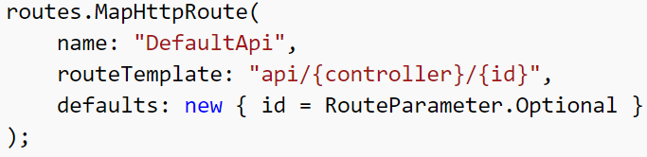
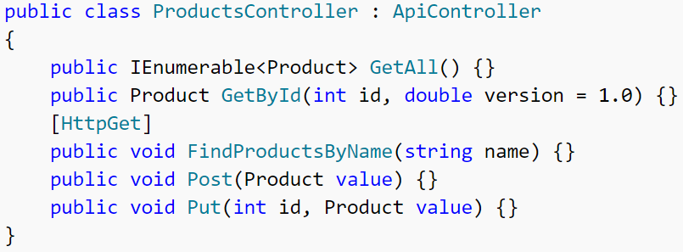
Routing and Action Selection
Action Selection

Slide 27
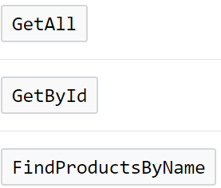
Routing and Action Selection
Action Selection
1. Create a list of all actions on the controller that match the HTTP request method

Slide 28
Routing and Action Selection
Action Selection
2. If the route dictionary has an "action" entry, remove actions whose name does not match this value.

Slide 29
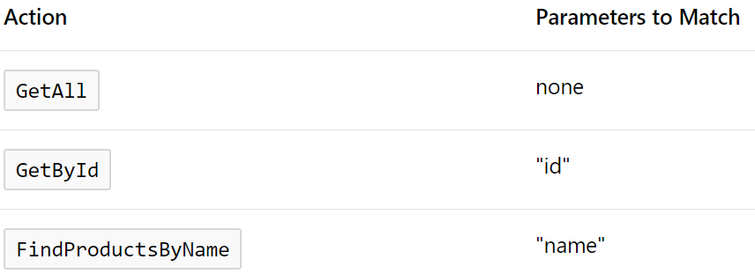
Routing and Action Selection
Action Selection
3. Try to match action parameters to the URI, as follows:
a. For each action, get a list of the parameters that are a simple type, where the binding gets the parameter from the URI. Exclude optional parameters

Slide 30

Routing and Action Selection
Action Selection
3. Try to match action parameters to the URI
b. From this list, try to find a match for each parameter name, either in the route dictionary or in the URI query string.
Matches are case insensitive and do not depend on the parameter order.

Slide 31


Routing and Action Selection
Action Selection
3. Try to match action parameters to the URI
c. Select an action where every parameter in the list has a match in the URI

Slide 32
Routing and Action Selection
Action Selection
3. Try to match action parameters to the URI
d. If more that one action meets these criteria, pick the one with the most parameter matches.

Slide 33
Routing and Action Selection
Action Selection
4. Ignore actions with the [NonAction] attribute.

Slide 34

Question???

Slide 35


